Slide 1
Austin Bike Sharing
Solving Austin’s Biggest Problem
Henry Chang | Vir Mehta Akhil Reddy | Rachel Rong

Slide 2

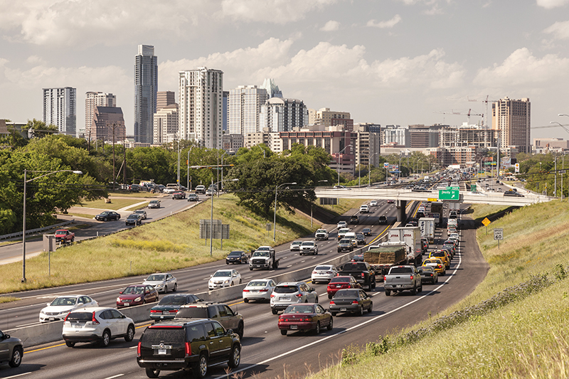


1
Objective
2
Approach
.
3
EDA
.
4
Insights and
Recommendations

Slide 3
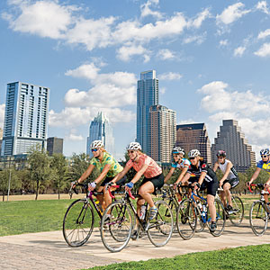
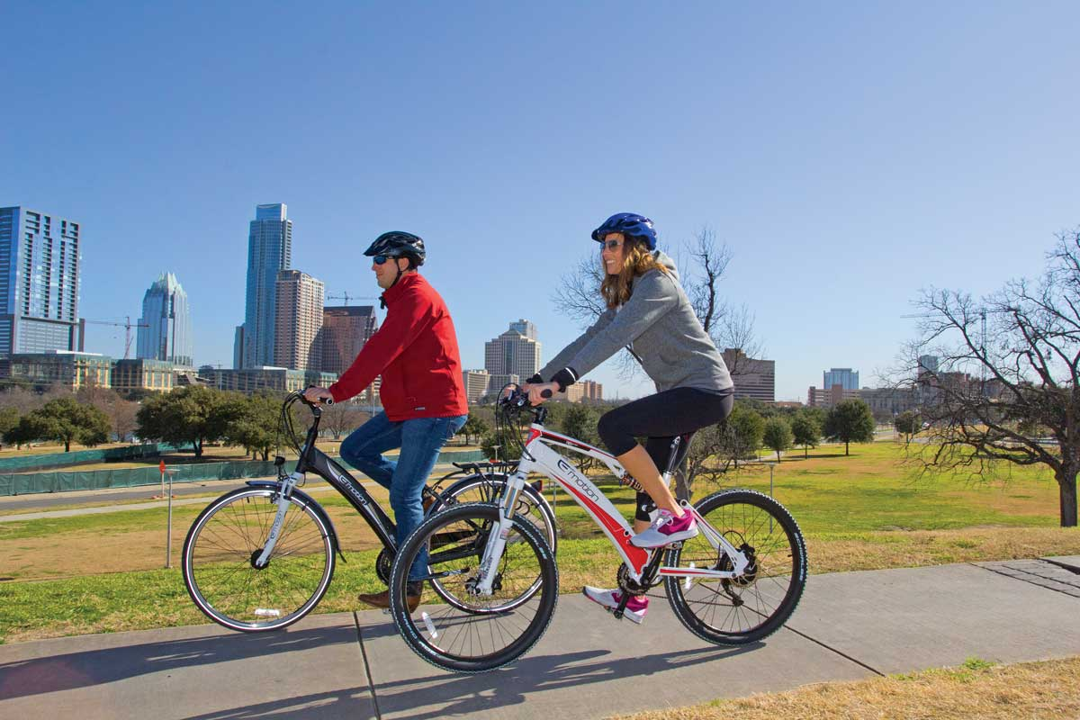
Objectives & Hopeful Outcomes
Objective
Efficient Allocation of Bikes
Willingness to Try
Less Cars on Roads
Health Benefits
Outcomes

Slide 4





Exploratory Data Analysis
Location
Membership
Time
Weather
Demographics
Location of Bike Stations
Rides per Station
Fastest Growing Stations
Identify Type of Bike Share User
Local30 / Local 365 Programs
Seasonality
Spikes in Demand
Days of the Week
Time of Day
SXSW & ACL
‘Too Hot’ & ‘Too Cold’ Temperatures
Impact of a Rainy Day on Demand
Based on Zip Codes of Stations
Residents that ‘Walk to Work’
Residents between ‘Ages 15 & 24’
*Datasets Used: Austin Bikeshare Stations, Austin Bikeshare Trips, Austin Weather, and Austin Traffic Count

Slide 5
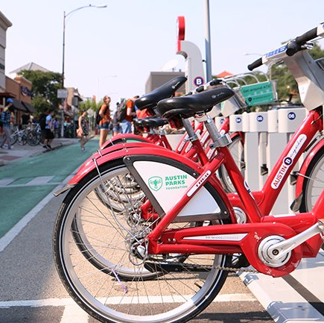
Location
Most Popular Stations
Station Name | Number of Rides | Annual Growth
Riverside @ S. Lamar | 8906 | 23%
Rainey St @ Cummings | 7684 | 12%
City Hall / Lavaca & 2nd | 7277 | -6%
2nd & Congress | 7265 | -12%
5th & Bowie | 6780 | -15%
Davis at Rainey Street | 6679 | 46%
Zilker Park | 6315 | -16%
4th & Congress | 6261 | 4%
Convention Center / 4th St. @ MetroRail | 6260 | 4%
Pfluger Bridge @ W 2nd Street | 6131 | 23%
Note: 2016 data has been considered to identify the busiest stations

Slide 6
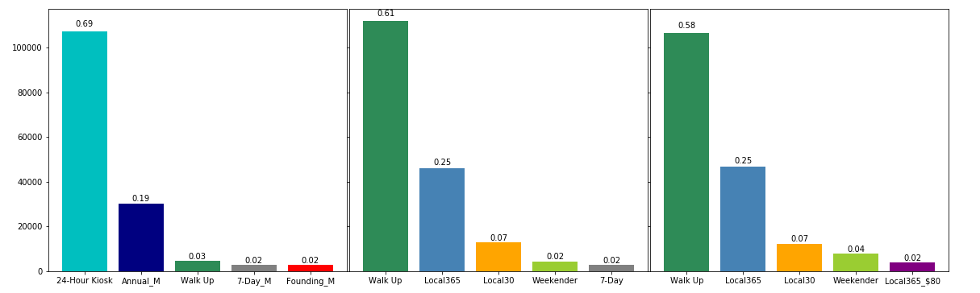
Membership
Types of Users
2014
2015
2016
Walk Up: Ad-Hoc Users
Local365: Annual Membership
Local30: Monthly Membership
Weekender: 3-Day Access Pass
Note: 24-hour Kiosk category has been dissolved since 2015

Slide 7
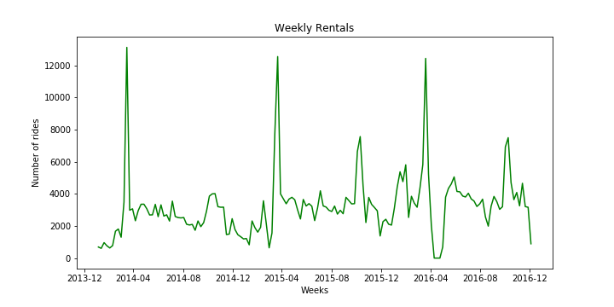
Time
Spikes in Rides during March & October
Note: Data from 2015 and 2016 is considered for analyzing the hourly trends

Slide 8
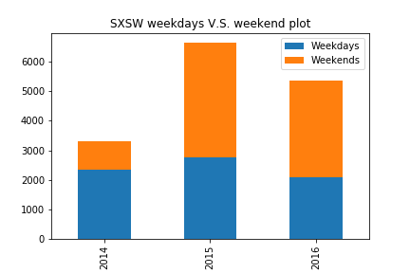
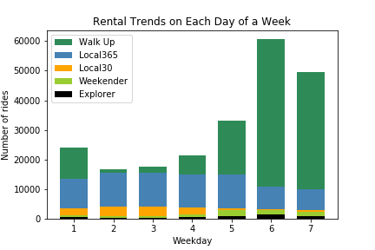
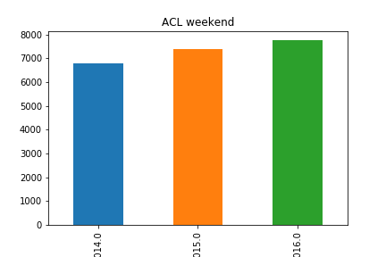
Time
Day of the Week (Including SXSW & ACL)
Note: 24-hour Kiosk category has been dissolved since 2015

Slide 9
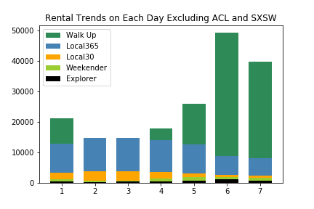
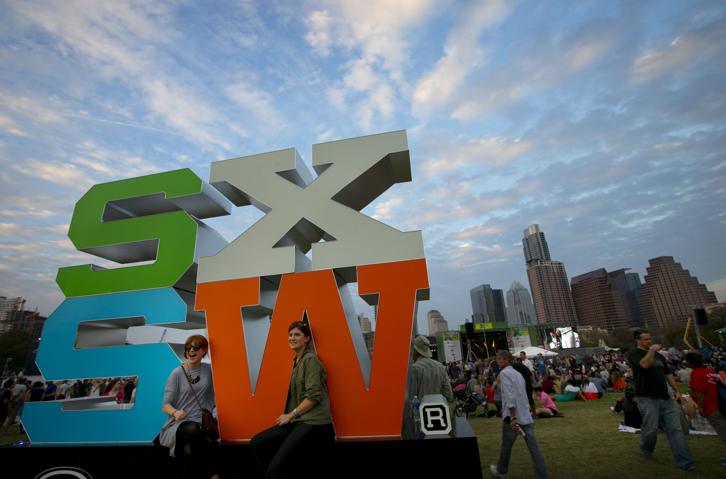
Time
Day of the Week (Not Including SXSW & ACL)
Note: 24-hour Kiosk category has been dissolved since 2015

Slide 10
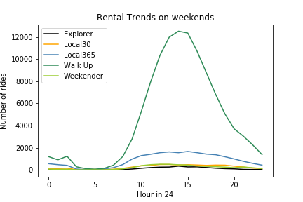
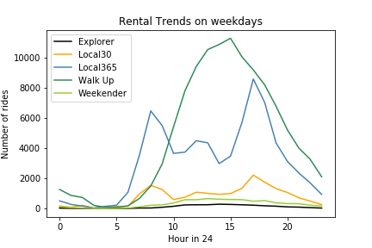
Time
Time of Day
Note: Data from 2015 and 2016 is considered for analyzing the hourly trends

Slide 11
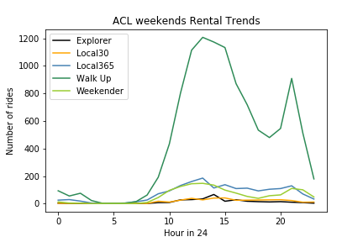

Time
Trends During ACL
Note: Data from 2015 and 2016 is considered for analyzing the hourly trends

Slide 12



Weather
Impact of Weather on Bike Sharing
Rainy Days
Hot Days
Cold Days
% Drop in Rides
67%
36%
72%
Note: Cold days : <60F, Hot days: >80F

Slide 13

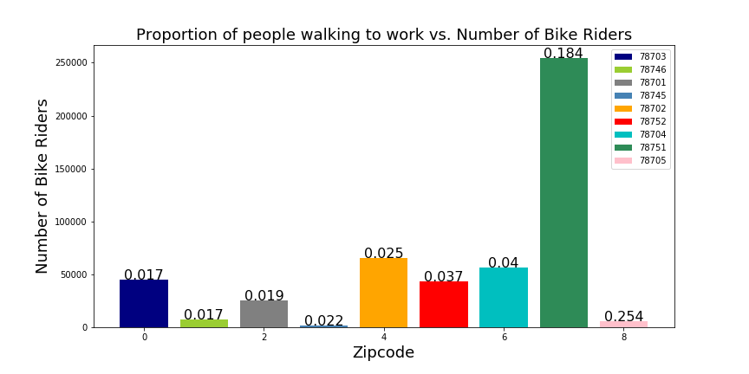
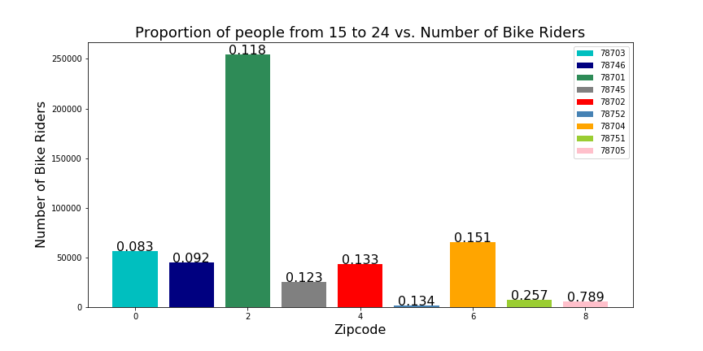
Demographics
Demographic Factor
Note: 24-hour Kiosk category has been dissolved since 2015

Slide 15
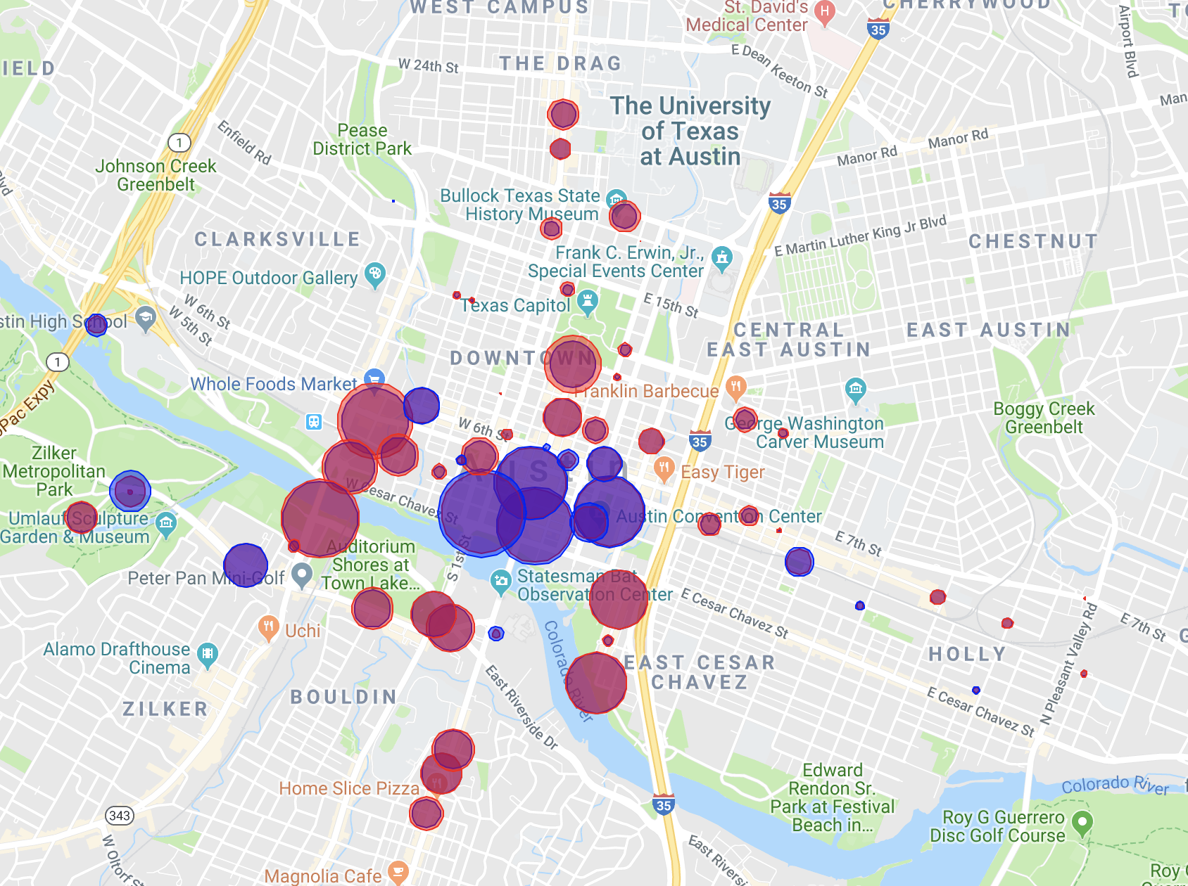
Insights - Trend in General
Bike Borrow and Return on Google Maps
More Return
More Borrow

Slide 16
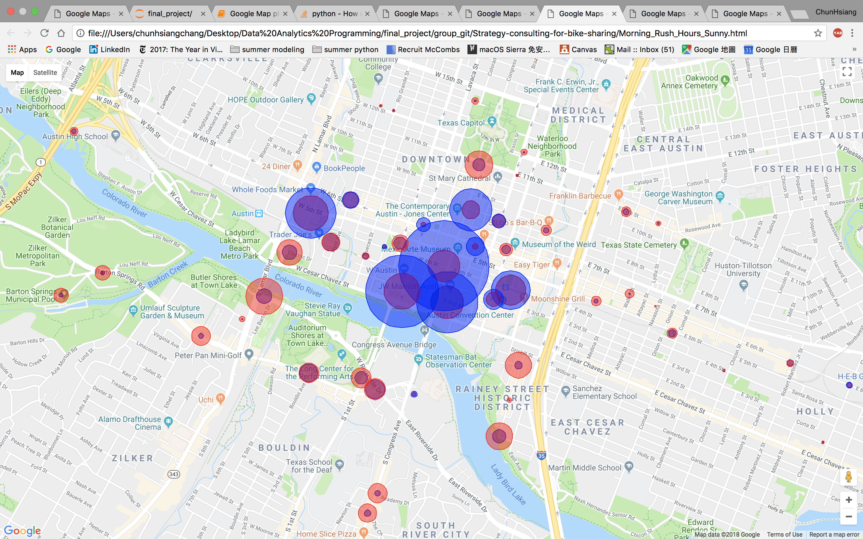
Rush Hour Sunny Day
Bike Borrow and Return on Google map
More Return
More Borrow

Slide 17
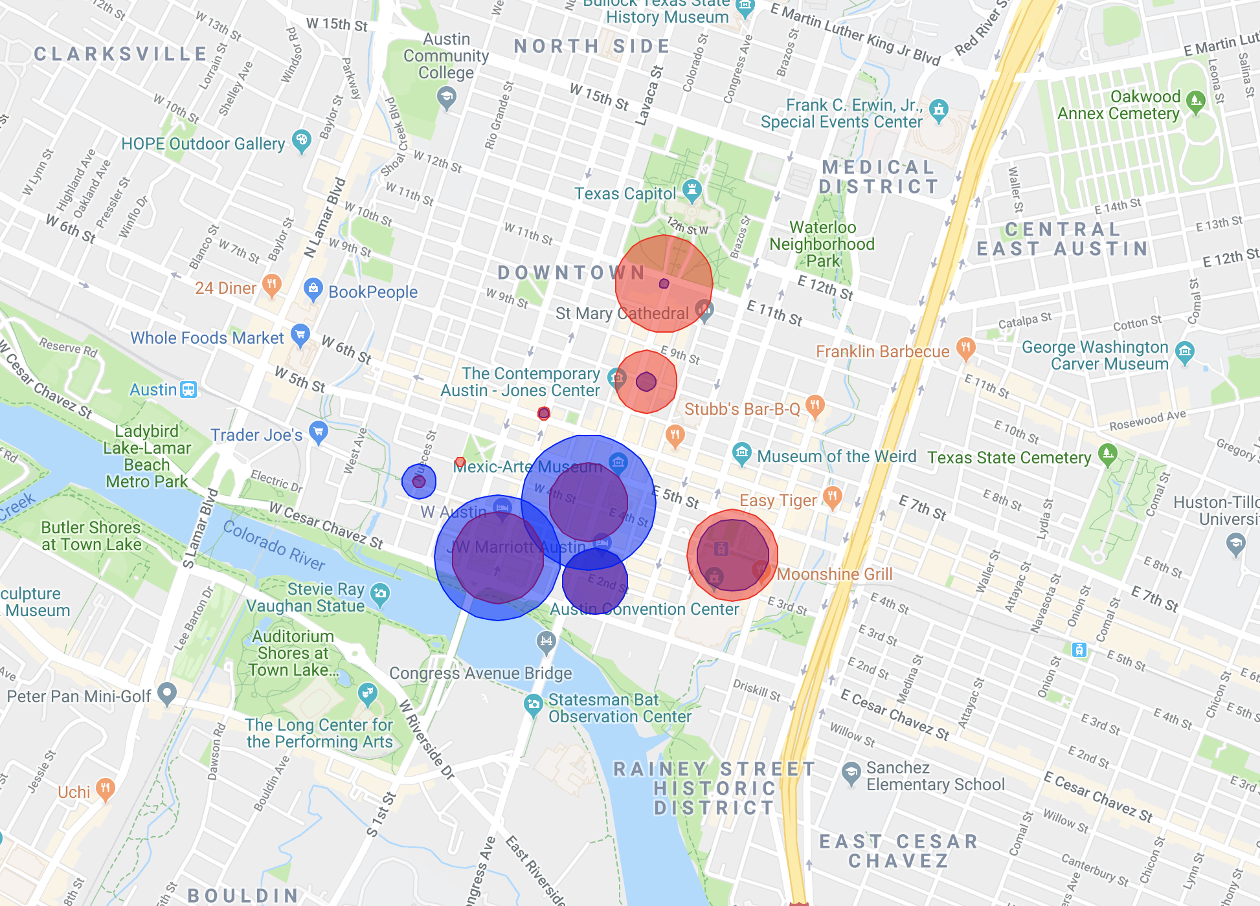
Rush Hour Rainy Day
Bike Borrow and Return on Google map
More Return
More Borrow

Slide 18
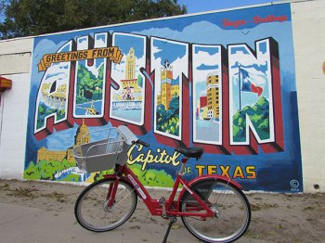
Thank You

